Slide 1

Scaling SQL Server Beyond 1 Disk
=tg= Thomas Grohser

Slide 2


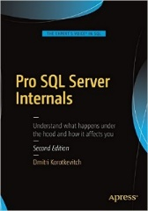


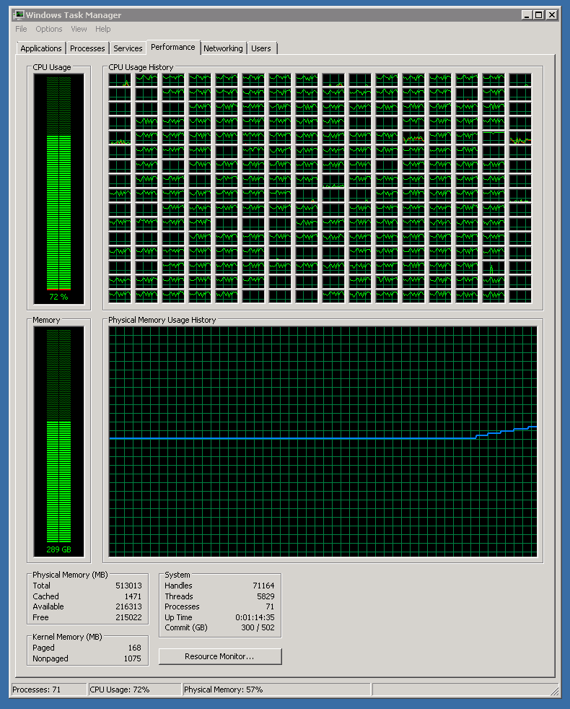

select * from =tg= where topic =
@@Version | Remark
SQL 4.21 | First SQL Server ever used (1994)
SQL 6.0 | First Log Shipping with failover
SQL 6.5 | First SQL Server Cluster (NT4.0 + Wolfpack)
SQL 7.0 | 2+ billion rows / month in a single Table
SQL 2000 | 938 days with 100% availability
SQL 2000 IA64 | First SQL Server on Itanium IA64
SQL 2005 IA64 | First OLTP long distance database mirroring
SQL 2008 IA64 | First Replication into mirrored databases
SQL 2008R2 IA64 SQL 2008R2 x64 | First 256 CPUs & >500.000 STMT/sec First Scale out > 1.000.000 STMT/sec First time 1.2+ trillion rows in a table
SQL 2012 | > 220.000 Transactions per second > 1.3 Trillion Rows in a table
SQL 2014 | > 400.000 Transactions per second Fully automated deploy and management
SQL 2016 | AlwaysOn Automatic HA and DR, crossed the PB in storage
SQL 2017 | In production 3 minutes after RTM
SQL 2019 | > 3 trillion rows in one table > 10 PB of data
SQL 2022 | Can’t wait to push the limits even further
=tg= Thomas Grohser,
Enterprise Database Infrastructure Architect and Engineer
email: tg@grohser.com
Focus on SQL Server Security, Performance Engineering,
Infrastructure and Architecture
Helped Writing
Close Relationship with
SQLCAT (SQL Server Customer Advisory Team)
SCAN (SQL Server Customer Advisory Network)
TAP (Technology Adoption Program)
Product Teams in Redmond

Slide 3
What we expect from Storage
Persistence
Don’t lose the data
Performance
Being able to read and write it fast
Preservation
Return the same data that you sent
Protection
Ensure the data can’t be stolen

Slide 4
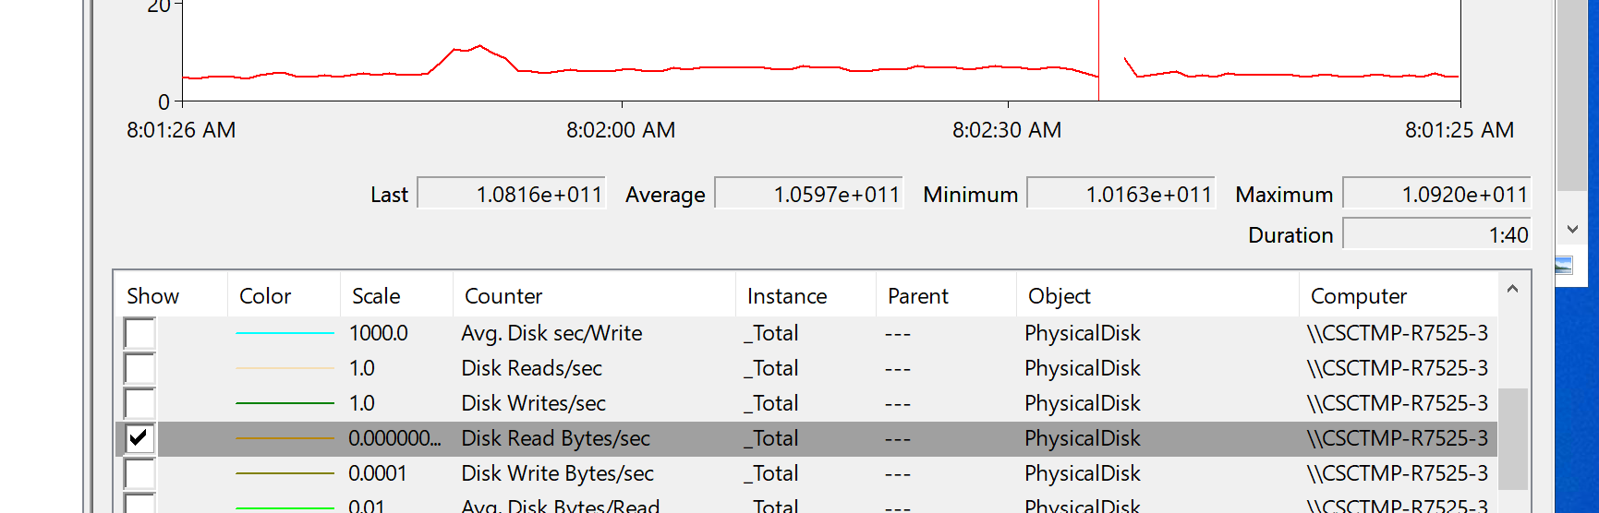
How do you know your storage is faster than average?
This is 98.69 GB/s

Slide 5
3 Dimension of Storage
Size (Capacity)
How much data can I store
Scale: Easy - buy more
Throughput
How many GB per second can I read or write
Scale: Easy – buy multiple
Latency
How long does a single IO take
Scale: Hard – find a technology with lower latency

Slide 6
SQL Server IO
Database
Latency
Throughput
+
Latency
Transaction-Log File
Data File(s)
Throughput
Backup File(s)

Slide 7
SQL Server I/O Characteristics
Workload | Type | Block Size
Log writes | Sequential | Up to 60KB
Checkpoint / Lazy Write | Random | Up to 256KB
Index Seeks | Random | 8KB 64KB (read Ahead)
Table / Range Scan | Sequential | 64KB-512KB
Bulk Load | Sequential | 64KB-256KB
Backup Operations | Sequential | 64KB-4MB
SQL 2014 Hekaton None Durable Tables | None | None

Slide 8
Why Do We Need Fast Data Reads?
SQL Server can do a lot of IO
Every time SQL Server needs to pull data from disk into the buffer pool the speed of the disk it reads the data from is the bottleneck.
Throughput is needed when it comes to table scans and low latency is needed for random IO.

Slide 9
Why Do We Need Fast Backups?
While a backup is running the database is in a vulnerable state.
Certain operations are nor possible or can’t be performed
The log can not be truncated
→ The longer the backup takes the more log space you need
You can’t add or remove a file from a database
→ If the log is filling and you run out of disk space you can’t add a temporary second log file on an additional disk. There is also a maximum size for the tlog file of 2 TB per file

Slide 10
Throughput vs Size
 | 1 TB | 2 TB | 5 TB | 10 TB | 20 TB | 50 TB | 100 TB | 200 TB | 500 TB | 1 PB | 2 PB
1 GB/s | 17.1 | 34.1 | 85.3 | 170.7 | 341.3 | 853.3 | 1,706.7 | 3,413.3 | 8,533.3 | 17,066.7 | 34,133.3
2 GB/S | 8.5 | 17.1 | 42.7 | 85.3 | 170.7 | 426.7 | 853.3 | 1,706.7 | 4,266.7 | 8,533.3 | 17,066.7
4 GB/s | 4.3 | 8.5 | 21.3 | 42.7 | 85.3 | 213.3 | 426.7 | 853.3 | 2,133.3 | 4,266.7 | 8,533.3
8 GB/s | 2.1 | 4.3 | 10.7 | 21.3 | 42.7 | 106.7 | 213.3 | 426.7 | 1,066.7 | 2,133.3 | 4,266.7
16 GB/s | 1.1 | 2.1 | 5.3 | 10.7 | 21.3 | 53.3 | 106.7 | 213.3 | 533.3 | 1,066.7 | 2,133.3
32 GB/s | 0.5 | 1.1 | 2.7 | 5.3 | 10.7 | 26.7 | 53.3 | 106.7 | 266.7 | 533.3 | 1,066.7
64 GB/s | 0.3 | 0.5 | 1.3 | 2.7 | 5.3 | 13.3 | 26.7 | 53.3 | 133.3 | 266.7 | 533.3
128 GB/s | 0.1 | 0.3 | 0.7 | 1.3 | 2.7 | 6.7 | 13.3 | 26.7 | 66.7 | 133.3 | 266.7
Network based Storage (Cloud) 1 … 4 GB/s
SAN based storage 2 … 16 GB/s with the majority in the 4-8 GB/s range
DAS (NVMe) 2 … 100+ GB/s between 2 and 6 GB/s per disk

Slide 11
Why Do We Need Fast Tlog Writes?
All operations that modify data need to log the operations. A slow log will be the bottleneck for all operations that change data:
Insert
Update
Delete
Merge
Bulk Insert
Alter Index
Alter Table
…

Slide 12
Latency vs Throughput on Sequential IO
Latency ms | Logwrites per Second | Throughput
100 | 10 | 0.59 | MB/s
50 | 20 | 1.17 | MB/s
20 | 50 | 2.93 | MB/s
10 | 100 | 5.86 | MB/s
5 | 200 | 11.72 | MB/s
2 | 500 | 29.30 | MB/s
1 | 1000 | 58.59 | MB/s
0.5 | 2000 | 117.19 | MB/s
0.2 | 5000 | 292.97 | MB/s
0.1 | 10000 | 585.94 | MB/s
0.05 | 20000 | 1.14 | GB/s
0.02 | 50000 | 2.86 | GB/s
0.01 | 100000 | 5.72 | GB/s
0.005 | 200000 | 11.44 | GB/s
0.002 | 500000 | 28.61 | GB/s
Overloaded SAN
Regular SAN
High Performance SAN
SSD
NVMe Disk
NV DIMM

Slide 13
Raw Storage Devices
HDD (Spinning Disk)
Should not be used for databases any more
SSD/NVMe (Solid State Disk, Flash)
Current best choice for most database needs
PMEM (Persistent Memory)
Discontinued by Intel
NVDIMM (non-volatile dual in line memory)
Extreme cases. If you think you need that we should talk

Slide 14
Interfaces on the Storage Device
Memory NVDIMM, PMEM
PCIe NVMe SSD
SAS SSD, HDD
SATA SSD, HDD
FC HDD, SAN
No longer used: ATA, PATA, SCSI, Fast-SCSI UW-SCSI, ST-506, ST-412, …

Slide 15
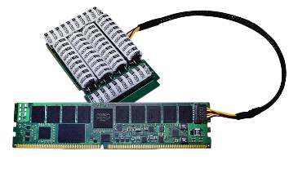
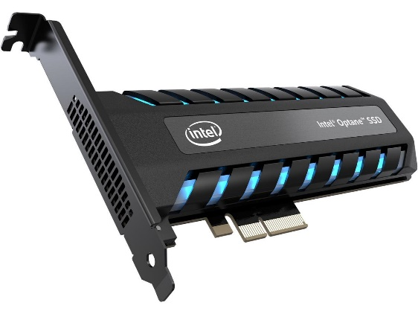

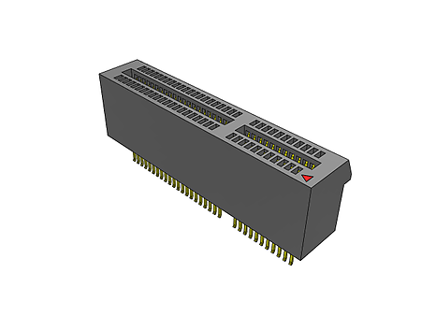
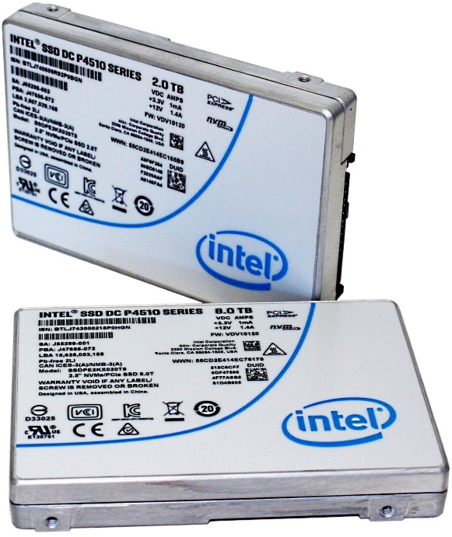
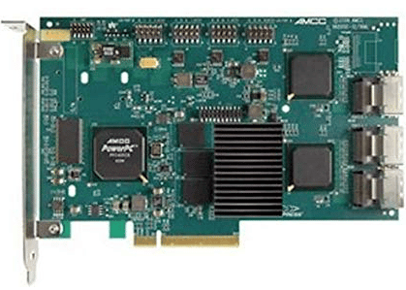
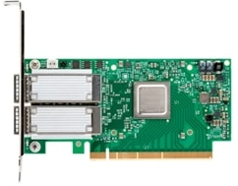
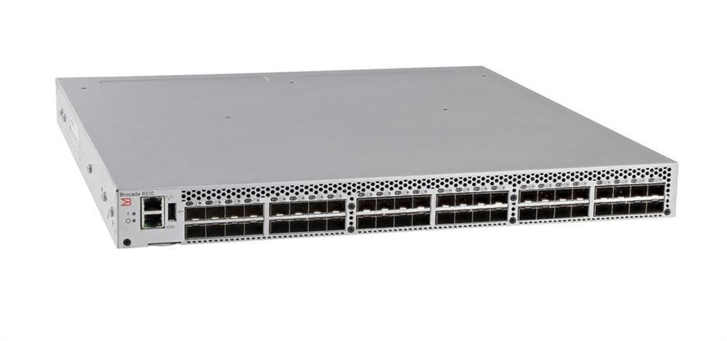
How to Connect Storage Devices
NVDIM, PMEM
NVMe
NVMe, SSD, HDD
SAN

Slide 16
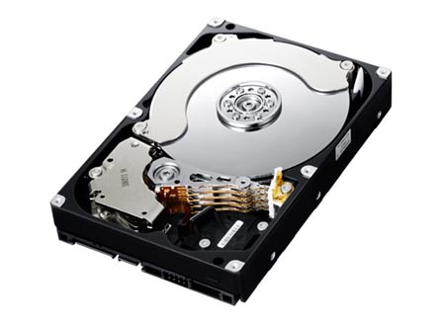

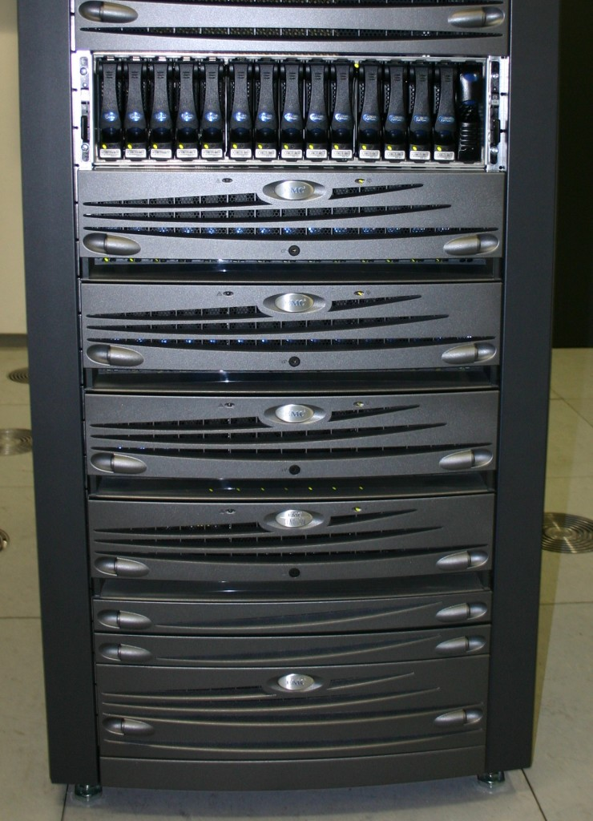
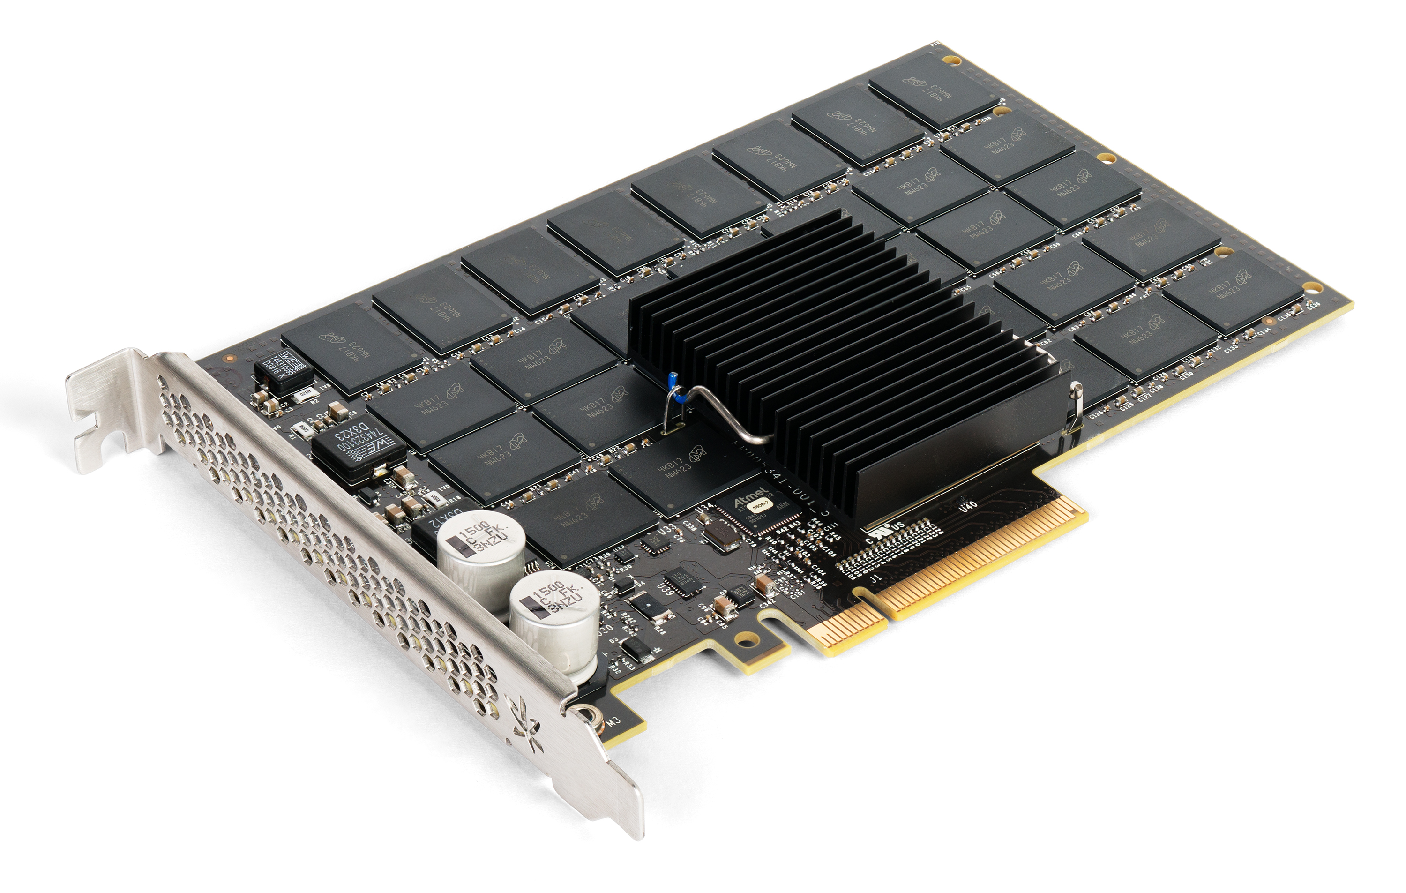
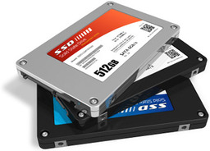
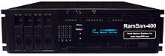
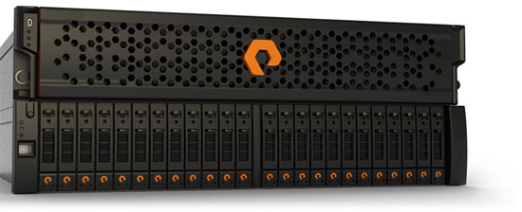
Storage Technology Over Time
40 MB in about 10 minutes
40 MB
600 kb/s
27 ms
5 MB/s
Hard Disk
RAID
Storage Array
SAN
1+ PB
8 GB/s
0.2 ms
2 GB/s
RAM SAN
All Flash Array
Fusion IO
SSD
1 PB in about 1 ½ days

Slide 17


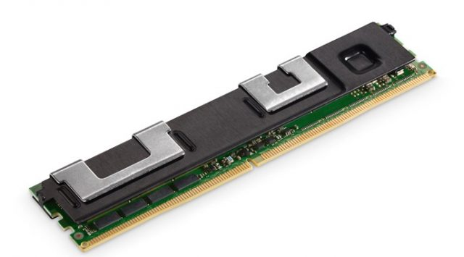
Current Storage Options
NVMe Disk
PCIe Card
NVDIMM
PMEM – Optane DC Persistent Memory
1 PB in about 70 Minutes
Latency measured in µs and ns
24 TB in about 300 seconds
1.5 TB in about 3 seconds

Slide 18
IOPS
This measurement has no meaning unless the size of the IO is specified
10000 IOPS
10000 IOPS @ 4 MB = 40 GB/s
10000 IOPS @ 8 KB = 0.08 GB/s = 80 MB/s

Slide 19
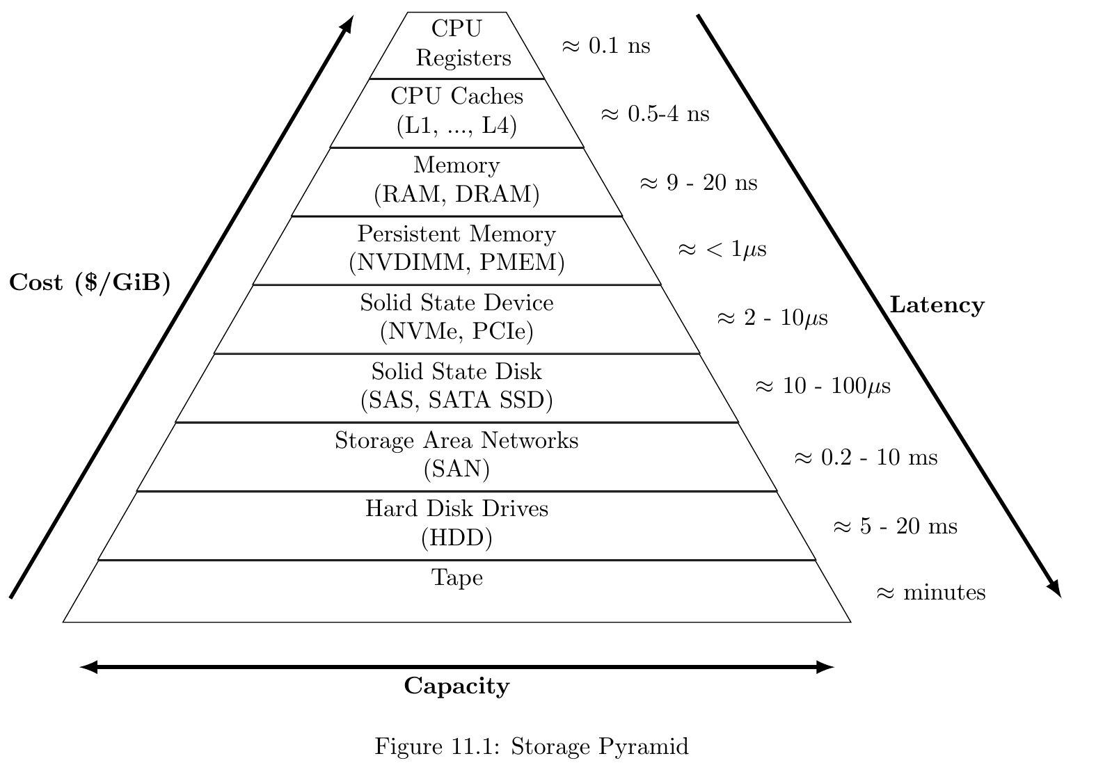
Storage Pyramid

Slide 20
Undetectable Write Error
Data is stored in sectors of 512 or 4096 bytes
Storage devices keep checksums to figure out if all is OK
UWE happens if a multi bit flip results in the same checksum
About one per PB written

Slide 21
Undetectable Write Error – RAID Problem
Original data 1011101000101
RAID 1
Disk 1 stores 1011100100101 CS 01
Disk 2 stores 1011101000101 CS 01
You read disk 2 all is OK
You read disk 1 you get corrupted data
You read both you do not know which one is the correct one
Same problem on RAID 5

Slide 22
Undetectable Write Error – HW Solution
Tripple RAID 1
If one disk flips, the other two are still correct and the majority wins
RAID 6
Uses two different ways of calculating the parity and therefore can find the bad disk.
Careful not all RAID controllers implement data protection these days (sacrificed for performance) the ones that do might not have it on by default.

Slide 23
Undetectable Write Error – Software Solution
Use SQL Server Always On Availability Groups to have the data on multiple servers and use Page Checksums to verify the data on the disk.
Consider even not having any RAID protection on the individual servers.
You need a pair of servers anyway for HA/DR
Three servers without RAID might be more cost effective than two with RAID protection

Slide 24

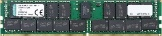

Balance the System Resources between CPUs

Slide 25
The Ideal 1 CPU System
16x 8x 4x
NVMe
NVMe
NVMe
NVMe
NVMe
NVMe
NVMe
NVMe
NVMe
NVMe
NVMe
NVMe
NVMe
NVMe
NVMe
NVMe
NVMe
NVMe
NVMe
NVMe
RAID 6
RAID 6
Tripple R1
NVMe
NVMe
NVMe
NVMe
NVMe
NVMe
NVMe
NVMe
NVMe
NVMe
NVMe
NVMe
NVMe
NVMe
NVMe
NVMe
RAID 6
RAID 6
NVMe
NVMe
NVMe
NVMe
NVMe
NVMe
NVMe
NVMe
NVMe
NVMe
NVMe
NVMe
NVMe
NVMe
NVMe
NVMe
RAID 6
RAID 6
Dual Port 100 GE

Slide 26
The Ideal 2 CPU System
16x 8x 4x
NVMe
NVMe
NVMe
NVMe
NVMe
NVMe
NVMe
NVMe
NVMe
NVMe
NVMe
NVMe
NVMe
NVMe
NVMe
NVMe
NVMe
NVMe
NVMe
NVMe
NVMe
NVMe
NVMe
NVMe
Tripple R1
Tripple R1
RAID 6
RAID 6
NVMe
NVMe
NVMe
NVMe
NVMe
NVMe
NVMe
NVMe
NVMe
NVMe
NVMe
NVMe
NVMe
NVMe
NVMe
NVMe
RAID 6
RAID 6
NVMe
NVMe
NVMe
NVMe
NVMe
NVMe
NVMe
NVMe
NVMe
NVMe
NVMe
NVMe
NVMe
NVMe
NVMe
NVMe
RAID 6
RAID 6
Dual Port 100 GE
Dual Port 100 GE

Slide 27
Read Ahead happens if …
The next data needed is in contiguous pages on the disk.
Problem with 2 or more tables that grow at the same time.

Slide 28
Problem with Multiple Data Files
1-3
5
8-9
…
2-4
6-7
…

Slide 29
SQL Server Startup Option -E
-E can be your friend if you have large tables
-E allocates 64 extent in a file before moving on to the next one
That is 4 MB at a time for each table instead of 64 KB

Slide 30
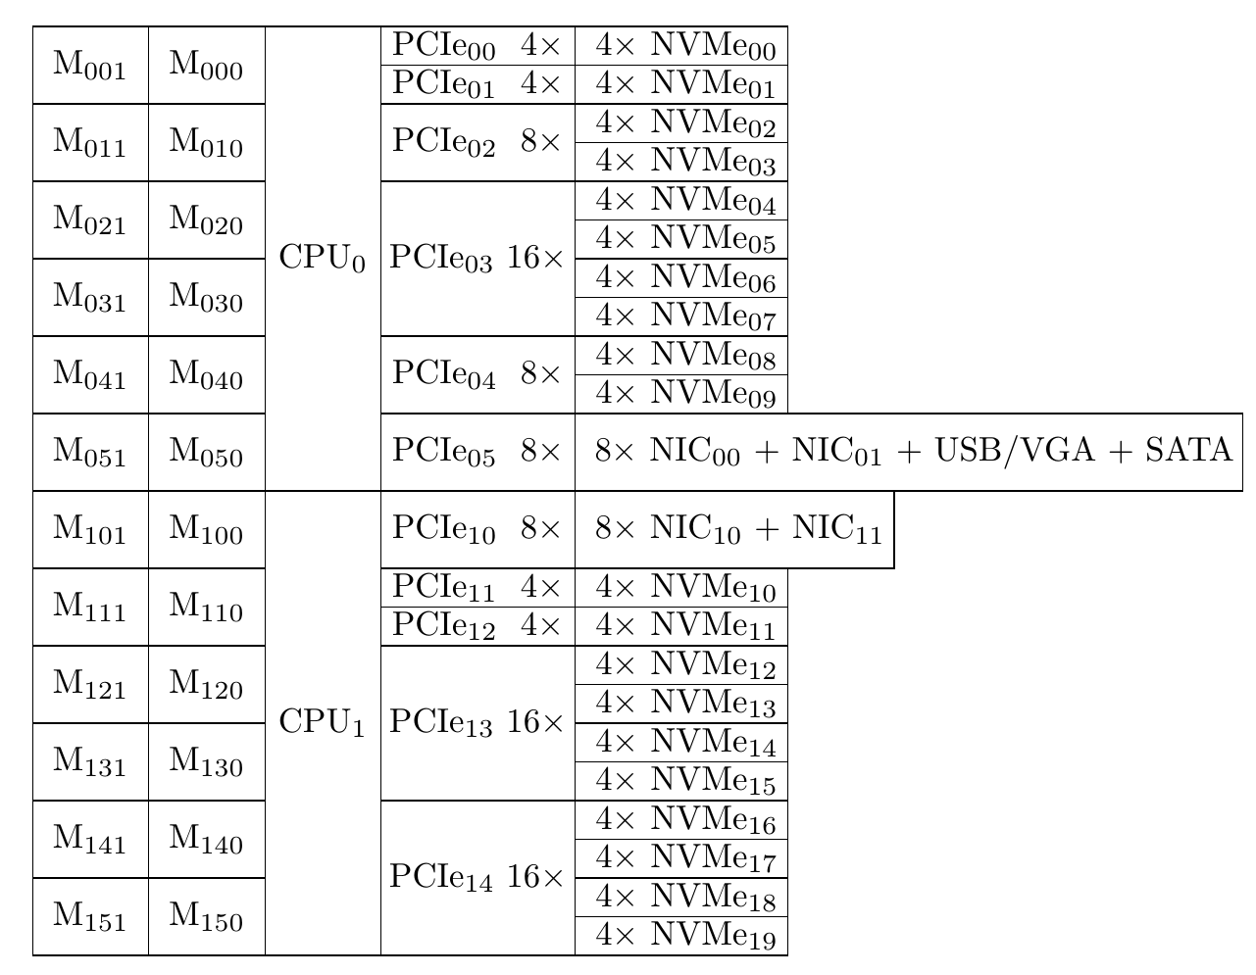
Commodity Server (Mixed Workload)
Two Socket Server (2 CPU’s, Intel or AMD)

Slide 31
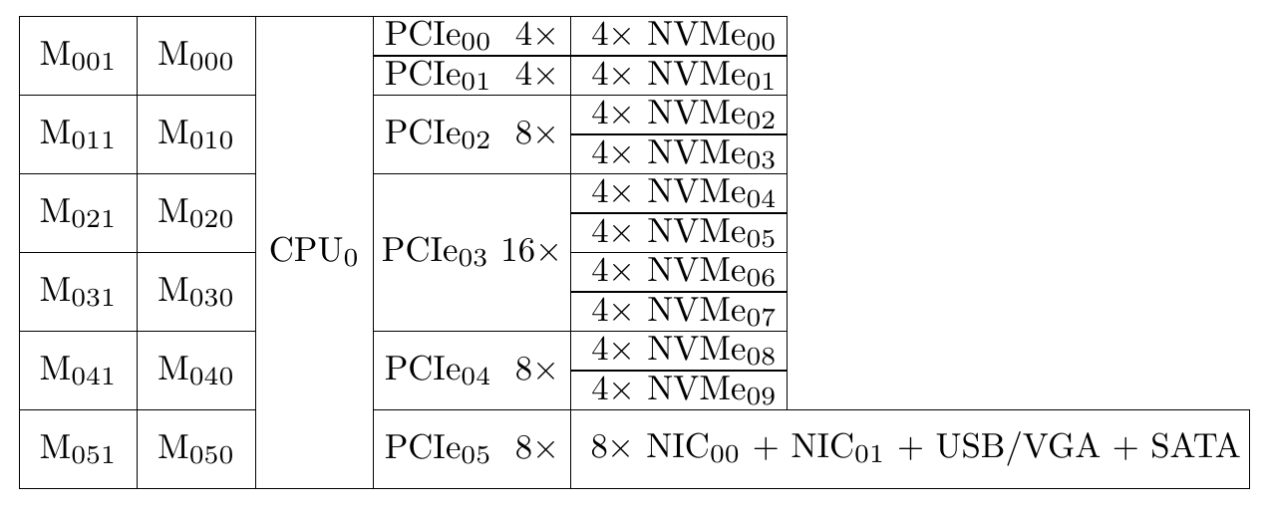

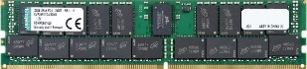
Low Latency Server (OLTP Workload)

Slide 32
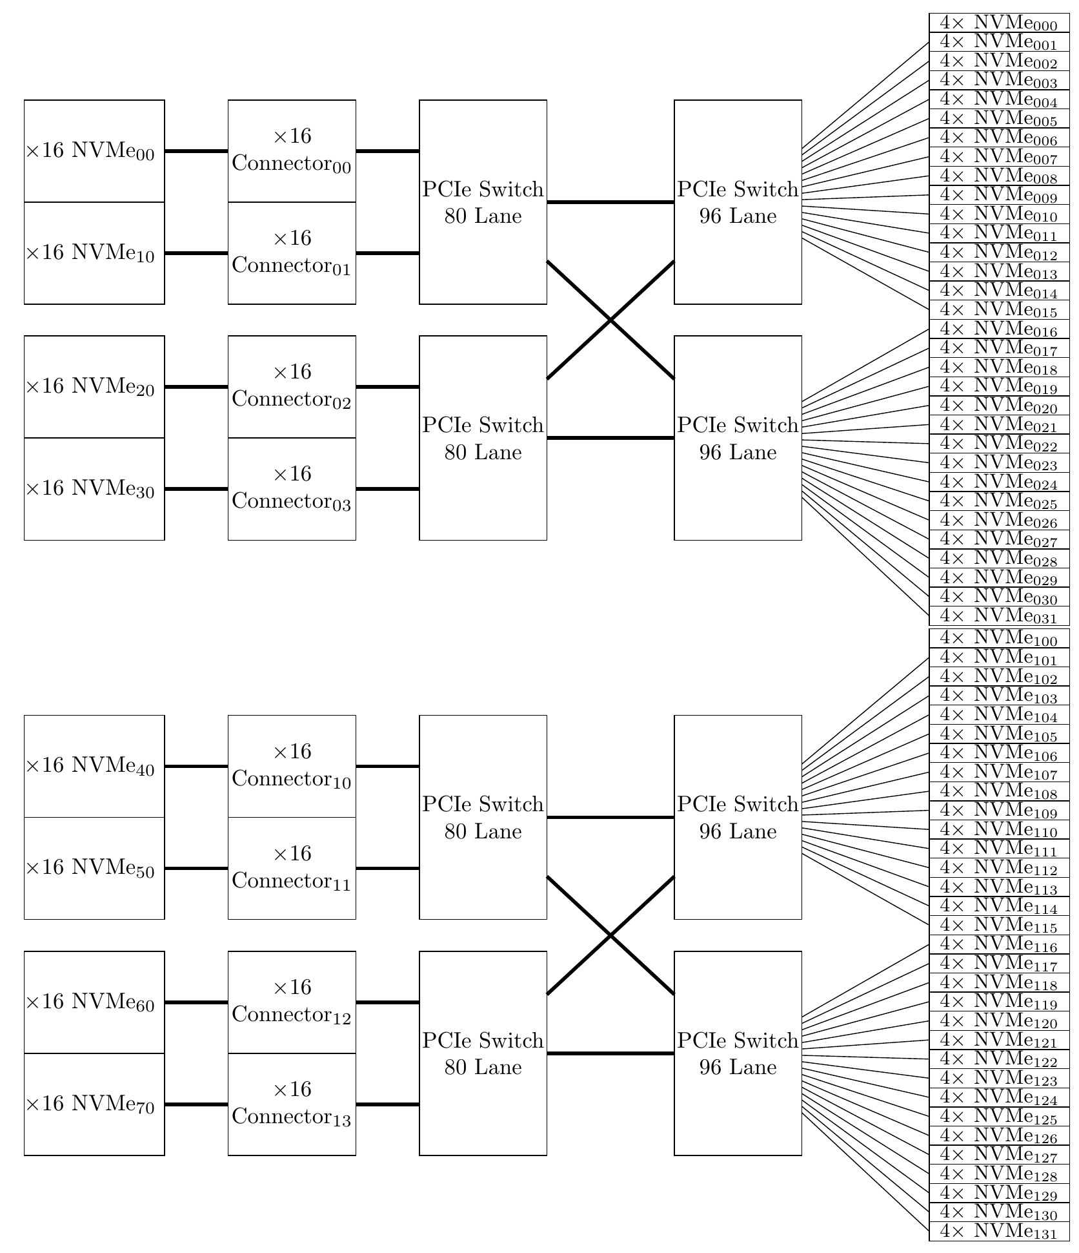
High Throughput Storage

